Slide 1

Bike Store Data Analysis
SQL Server and Tableau
By: Anuja Yawar

Slide 2
Introduction
The aim of this project is to create an executive dashboard for the team to analyze revenue across multiple states in the US, focusing on various parameters such as brand name, salesperson, customers, order year, region, and category of bikes.

Slide 3

Framework
FRAMEWORK
Data Exploration
Model
Deployment
4. Visualization in Tableau
Data Gathering
2. Creating Schema
3. SQL query to populated required table

Slide 4
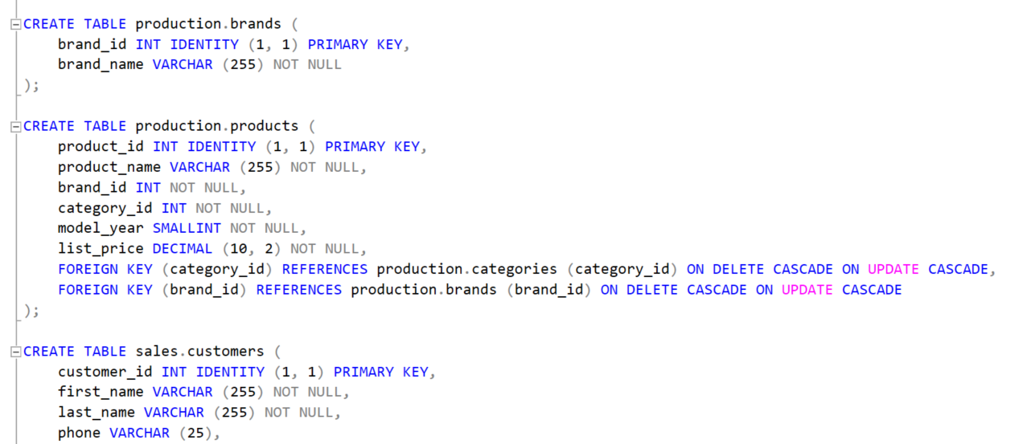
Gathering Data and Structure
The data is taken from Kaggle.com
Created a Schema in SQL and defined tables with primary keys, column names, foreign keys and other revelant details

Slide 5
Loading and Data Manipulation
Data Loading:
Utilized SQL queries, such as INSERT statements, to load the gathered data into the schema.
Data Manipulation:
Executed queries to perform necessary transformation and calculations
Ensured data is consistent and accurate

Slide 6
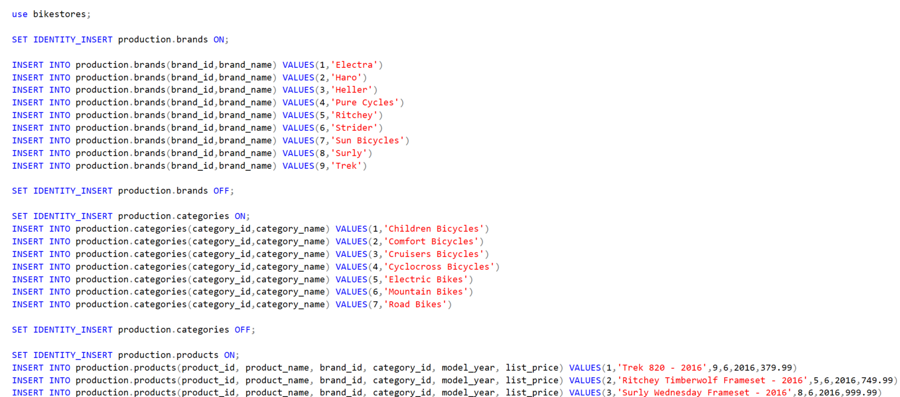
Snapshot of SQL queries – Data insertion

Slide 7
Querying Relevant Information
Query Execution:
Utilized SQL queries to extract necessary information from the tables created in the schema
Performed joins and other functions to obtain required data
Generated Table:
Produced a comprehensive table incorporating relevant columns and data

Slide 8
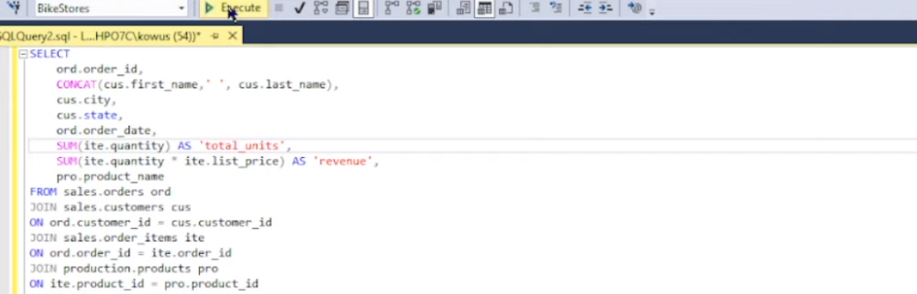
SQL query for generating table

Slide 9
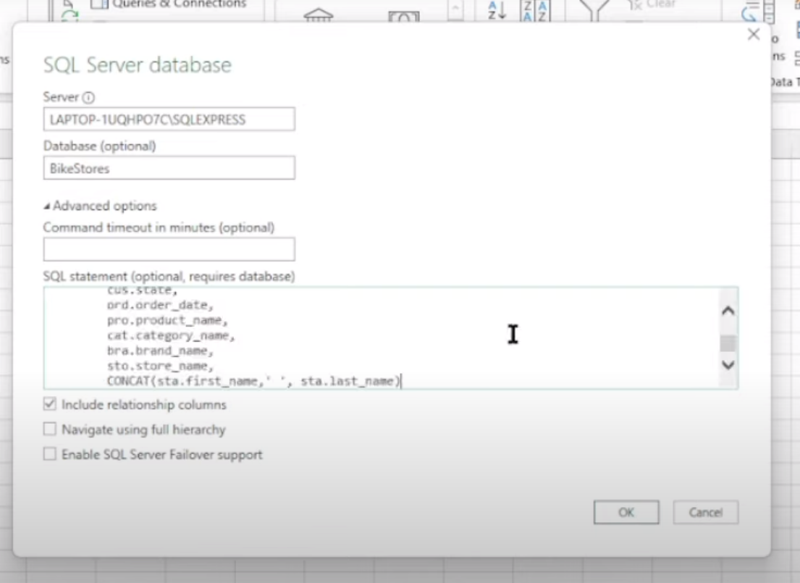
SQL to Excel connection
To utilize the generated table in Tableau there are two ways:
1. Connect the SQL Server directly to Tableau.
2. Save the generated table into Excel and connect Excel file to Tableau
For the sake of project I am going with first step. So each time the data is updated with new values in SQL server, Excel files are also updated with new values.
A snapshot of SQL server to connection is shown in the right picture.

Slide 10
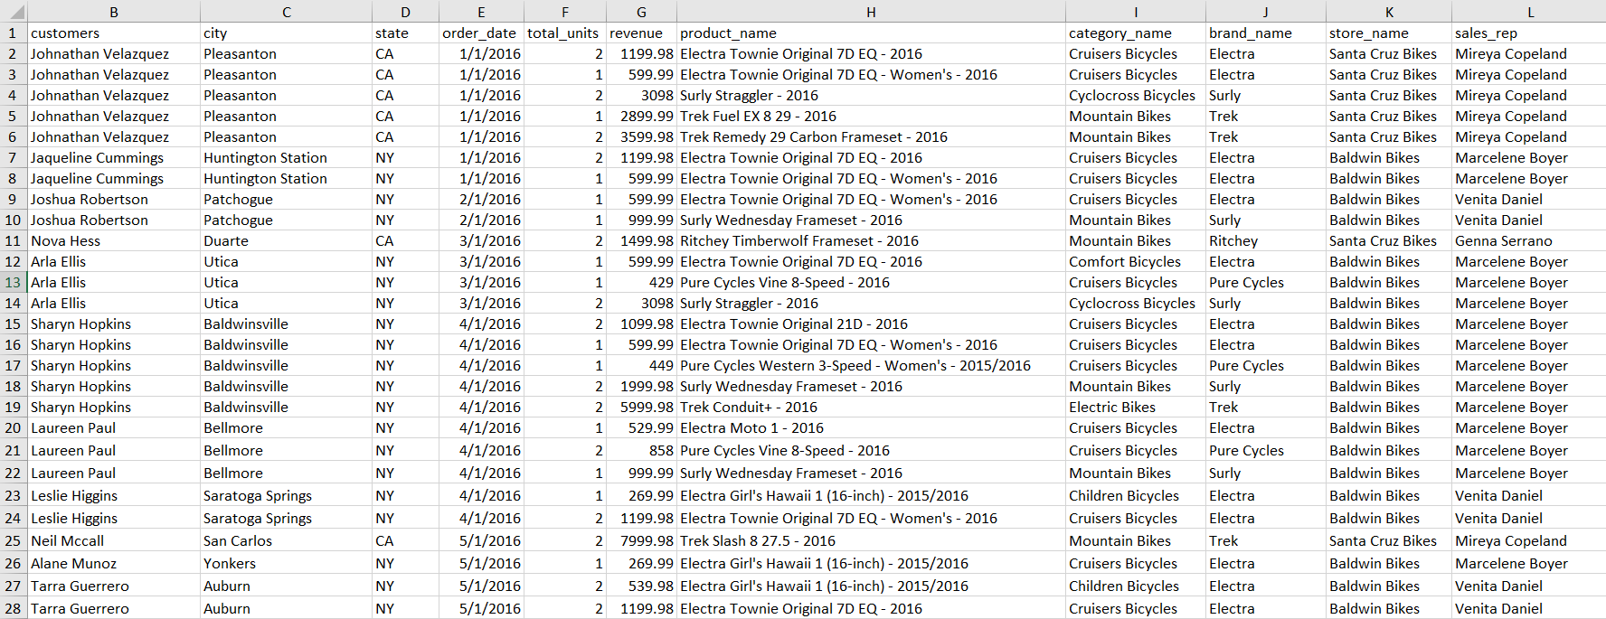
How does the generated table looks like?
File link: https://docs.google.com/spreadsheets/d/1Al667NYYURl0hgHelZckFqi5UnTV4dS4_NrYpzKiQsc/edit?pli=1#gid=609722551

Slide 11
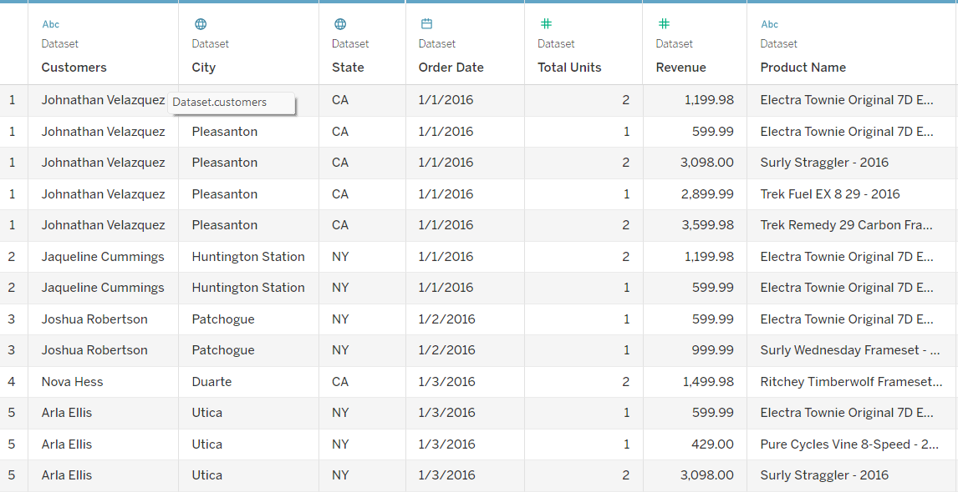
Connecting to Tableau and Dashboard Creation
Excel file is loaded into Tableau.
After that I have performed sanitary checks (null values, data types, duplicates, number of records etc.)
to see if the data in Tableau is correctly populated.

Slide 12
Interaction Dashboard
Created multiple worksheets, incorporating parameters and calculated fields
Constructed the executive dashboard for revenue analysis across states
The interactive dashboard provides a comprehensive analysis of revenue in the Bikestore project, presenting key insights through various charts and visualizations.
Link to the dashboard: Bikestore | Tableau Public
See next slide for dashboard navigation instructions.

Slide 13
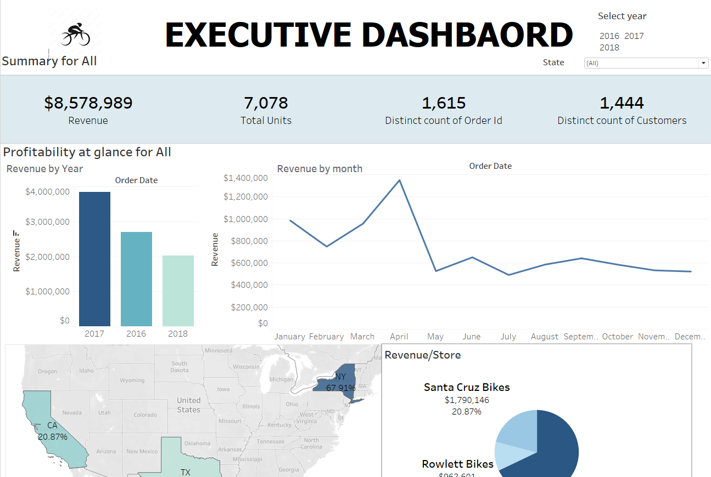
Navigation
The interactive dashboard serves as a comprehensive tool for monitoring key performance indicators (KPIs) related to the Bikestore project.
Core KPIs: The dashboard highlights essential metrics and insights for revenue analysis across CA, TX and NY
Current Filter Status:
The dashboard is currently displaying data without any applied filters.
This allows for a holistic view of the revenue across various parameters.

Slide 14
Chart Information
Chart: Revenue/Year: Displays the total revenue generated each year (2016, 2017, 2018). Enables stakeholders to observe year-over-year revenue trends and identify growth or decline patterns.
Chart: Revenue/Month: Presents the revenue distribution on a monthly basis. Allows for the identification of seasonal revenue patterns or monthly fluctuations.
Chart: Revenue/Region: Illustrates revenue distribution across different regions. Assists in identifying regions with the highest revenue contributions or potential growth opportunities
Chart: Revenue/Brand Name: Depicts the revenue generated by different brand names. Helps analyze the performance of individual brands and identify top-performing brands
Chart: Revenue/Store Name: Displays the revenue generated by each store. Assists in assessing store performance and identifying high-performing locations
Chart: Revenue/Bike Category: Illustrates the revenue distribution across different bike categories (e.g., mountain bikes, road bikes, hybrid bikes). Provides insights into the popularity and profitability of various bike categories
Chart: Top 10 Customers by Revenue: Presents the top 10 customers based on their revenue contributions. Helps identify valuable customers and tailor marketing strategies or customer retention initiatives
Chart: Revenue/Sales Representative: Highlights the revenue contribution of individual sales representatives. Allows for performance evaluation and identifying top-performing sales representatives
Further Exploration:
The dashboard can be expanded with additional charts and visualizations based on specific business needs.
Opportunities for deeper analysis include customer segmentation, product performance, and regional comparisons.

Slide 15
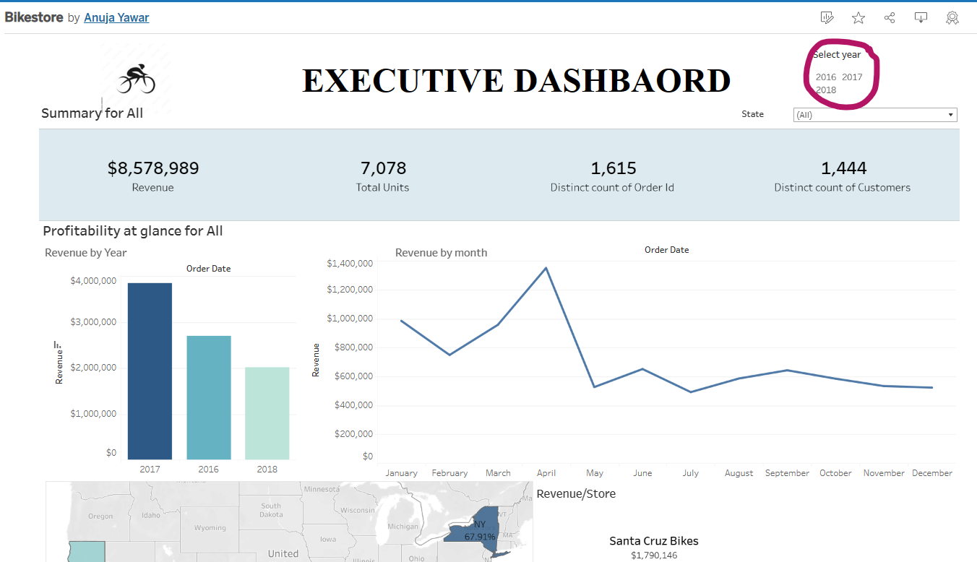
Interaction Element
You can filter each chart based on a year.
Refer the picture to the right.
Each chart in the dashboard changes accordingly to the year you choose.
Press ‘ESC’ key to infilter the dashboard.

Slide 16
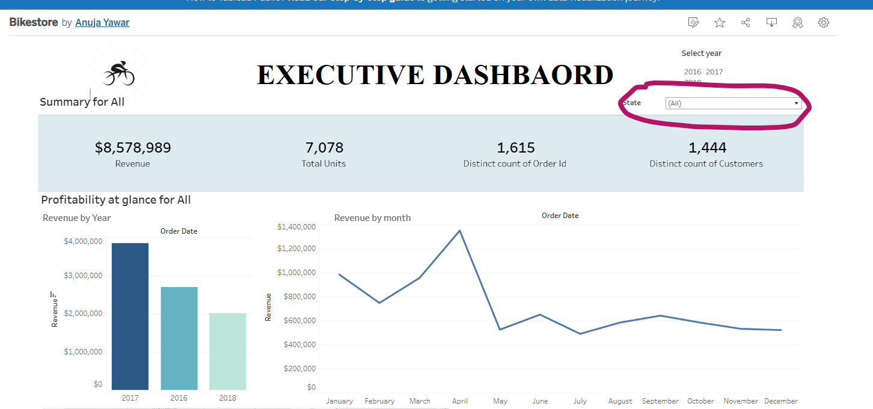
Interaction Element
You can also filter each chart based on a State.
Refer the picture to the right. Select any state from drop down list
Each chart in the dashboard changes accordingly to the State you choose.
Press ‘ESC’ key to infilter the dashboard.

Slide 17
Possible Recommendations
Analysis of Revenue in CA, TX, and NY:
CA, TX, and NY have shown varying levels of revenue generation, with NY having the highest and CA the lowest.
Possible Reasons for Revenue Discrepancy:
Market Potential: Explore the market potential in CA and assess any untapped opportunities that may exist.
Sales Strategies: Evaluate the effectiveness of sales strategies in CA and identify areas for improvement.
Outreach Team: Consider deploying the successful outreach

Slide 18
Possible Recommendations
Analysis of Brand Sales:
The analysis reveals that the majority of bikes are sold under the brand name Trek.
Steps to Enhance Sales of Other Brands:
Market Research: Conduct market research to understand customer preferences and demand for other brands.
Promotional Campaigns: Design targeted promotional campaigns to increase awareness and highlight the unique features of non-Trek brands.
Collaborations: Explore collaborations with influencers or local biking communities to promote and showcase other brands.
Incentives: Offer incentives such as discounts or special deals to encourage customers to try out and purchase non-Trek brands.
Product Differentiation: Ensure that non-Trek brands have distinct features, quality, or pricing that sets them apart and appeals to specific customer segments

Slide 19
Possible Recommendations
Analysis of Seasonal Trends:
Seasonal trends can provide valuable insights into bike sales patterns.
Leveraging Seasonal Trends:
Inventory Planning: Adjust inventory levels based on seasonal demand to ensure availability of popular bikes during peak seasons.
Marketing Campaigns: Design targeted marketing campaigns that align with seasonal trends, highlighting relevant features, promotions, or events.
New Product Launches: Consider launching new bike models or introducing special editions aligned with specific seasons to capitalize on customer interest.
Seasonal Discounts: Offer seasonal discounts or promotions to encourage customers to purchase bikes during off-peak seasons.
Seasonal Services: Provide seasonal services such as maintenance packages or bike tune-ups to cater to customers' needs during specific seasons.

Slide 20
Thank You

